Slide 1

Technology Usage and Trends Dashboard
APEKSHA A. KHOCHARE
27th APRIL, 2025

Slide 2




OUTLINE
Introduction
Executive Summary
Methodology
Programming Languages Trends
Current Year Trends
Future Trends
Database Trends
Current Database Usage
Future Database Demand
Dashboards
Current Technology Usage
Future Technology Trends
Demographics
Insights from Dashboard
Overall Findings and Implications
Conclusion

Slide 3

INTRODUCTION
Purpose of the Report To analyze developer survey data, capturing current technology usage, future trends, and demographic insights.
Target Audience
Hiring managers and recruiters
Technology team leaders and decision-makers
Educational institutions and training providers
Aspiring and professional developers
Value of the Report
Helps organizations understand technology adoption trends.
Assists in making informed decisions about tech investments and hiring.
Highlights opportunities for curriculum development in education and training.
Provides insights for developers to align their skills with industry demand.

Slide 4

EXECUTIVE SUMMARY
Current Technology Usage: Identified top 10 programming languages currently used by developers.
Future Technology Trends: Highlighted top 10 technologies developers want to work with in future (languages, databases, platforms, frameworks).
Demographics Overview: Mapped respondent distribution by country, age group, and education level.
Language Preferences: Developers showed strong interest in working with Python, JavaScript, and TypeScript.
Database Trends: PostgreSQL and MongoDB are the most desired databases for future work.
Platform Insights: Cloud platforms like AWS and Google Cloud dominate developer preferences.
Education and Age Correlation: Higher education levels are more common among older respondents.
Global Developer Community: Survey responses covered a diverse range of countries, showing the global nature of tech.

Slide 5

METHODOLOGY
Data Source
Developer Survey Data: survey_data_updated.csv
Collected from a global community of developers through an online survey.
Data Collection Method
Structured questionnaire distributed via online platforms.
Self-reported responses covering technology usage, preferences, and demographics.
Key Data Wrangling Steps
Removed rows with null or missing values to ensure accuracy.
Split multiple response fields (e.g., languages, platforms) into individual entries for analysis.
Filtered the top 10 entries for specific metrics like languages, databases, platforms, and frameworks.
Standardized field names for better readability in the dashboard.

Slide 6
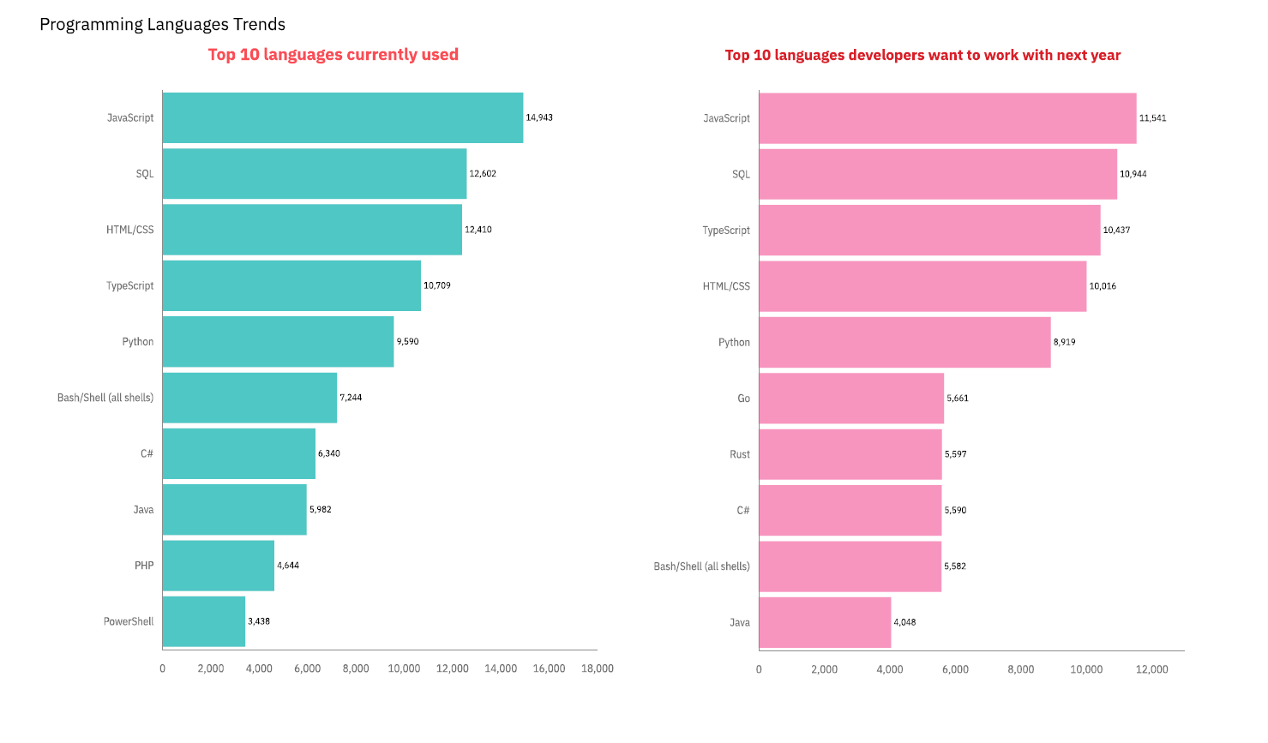
PROGRAMMING LANGUAGE TRENDS
Current Year
Next Year
<Bar chart of top 10 programming languages for the current year goes here.>
< Bar chart of top 10 programming languages for the next year goes here.>

Slide 7
PROGRAMMING LANGUAGE TRENDS - FINDINGS & IMPLICATIONS
Findings for Current Year
Implications for Current Year
Developers should prioritize learning JavaScript and Python for better job opportunities.
Web technologies continue to dominate the tech landscape.
JavaScript, Python, and HTML/CSS remain the most widely used languages.
Strong usage of TypeScript and Java among full-stack and backend developers.
Indicates a high demand for web development and data-related skills.
Findings for Next Year
Python and TypeScript are highly desired for future work.
Emerging interest in languages like Go and Kotlin.
Indicates a shift toward backend, mobile, and AI-related technologies.
Implications for Current Year
Upskilling in Python, Go, and Kotlin could prepare developers for future market trends.
Companies should support training in trending languages to retain talent.

Slide 8
Key Results and Insights
Current Technology Usage:
JavaScript, Python, and HTML/CSS are the top programming languages in use.
Web development skills are highly valued in the current job market.
🔹 Future Technology Trends:
Python, TypeScript, and Go are gaining popularity for future projects.
There's a clear shift toward backend development, AI, and cloud technologies.
🔹 Demographic Insights:
Majority of respondents are aged between 25–34 years.
Most have a Bachelor’s or Master’s degree.
Participants are globally distributed, with a strong presence from the US, India, and Europe.
🔹 Key Takeaways:
Developers are eager to learn modern, scalable technologies.
Companies must invest in training for emerging languages.
Understanding demographic trends helps tailor workforce strategies.

Slide 9
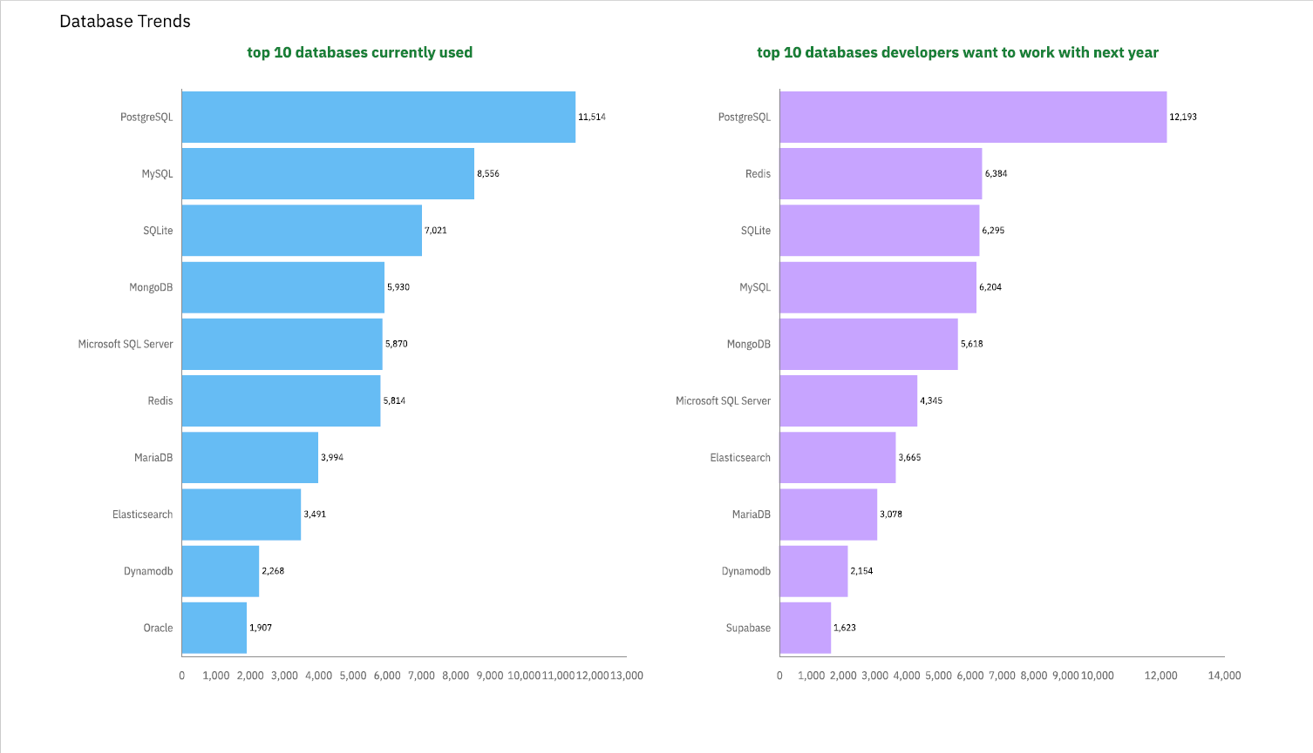
DATABASE TRENDS
Current Year
Next Year
< Bar charof top 10 databases for the current year goes here >
< Bar chart of top 10 databases for the next year goes here.>

Slide 10
DATABASE TRENDS - FINDINGS & IMPLICATIONS
Findings
Current Year — Top 10 Databases in Use
MySQL is the most widely used database, especially in web applications.
PostgreSQL is highly popular for its advanced features and open-source flexibility.
SQLite and MongoDB are strong choices for lightweight and NoSQL applications.
Traditional databases like SQL Server and Oracle still maintain a strong presence in enterprises.
Implications
Developers and analysts should maintain strong skills in SQL-based databases.
Companies continue to rely on relational databases for secure and scalable applications.
Knowledge of MongoDB provides an advantage for NoSQL-focused projects.
Next Year — Anticipated Future Demand (Short Version
PostgreSQL will dominate due to cloud adaptability.
MongoDB and Firebase will grow for real-time and mobile apps.
Cloud-native databases (AWS RDS, Firestore) are rising fast.
Oracle and SQL Server may decline slightly in new projects.
Cloud database skills (PostgreSQL on AWS, MongoDB Atlas, etc.) will be critical.
Developers should invest in learning NoSQL and serverless databases to stay competitive.
Future projects will prioritize scalability, flexibility, and real-time performance.

Slide 11
DASHBOARD
https://github.com/apeksha1403/-Tech-Trends-and-Demographic-Insights-Dashboard-

Slide 12
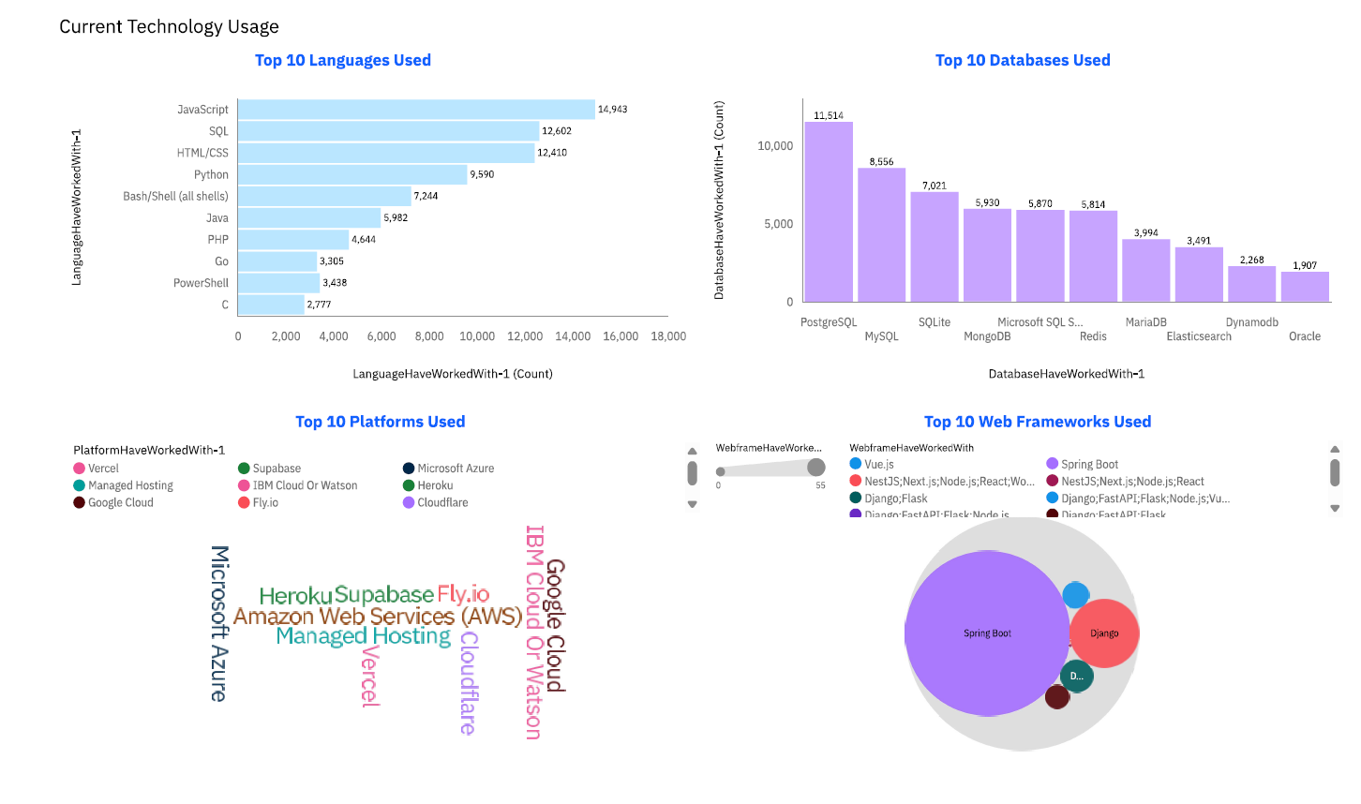
Current Technology Usage
Screenshot of dashboard tab 1 goes here

Slide 13
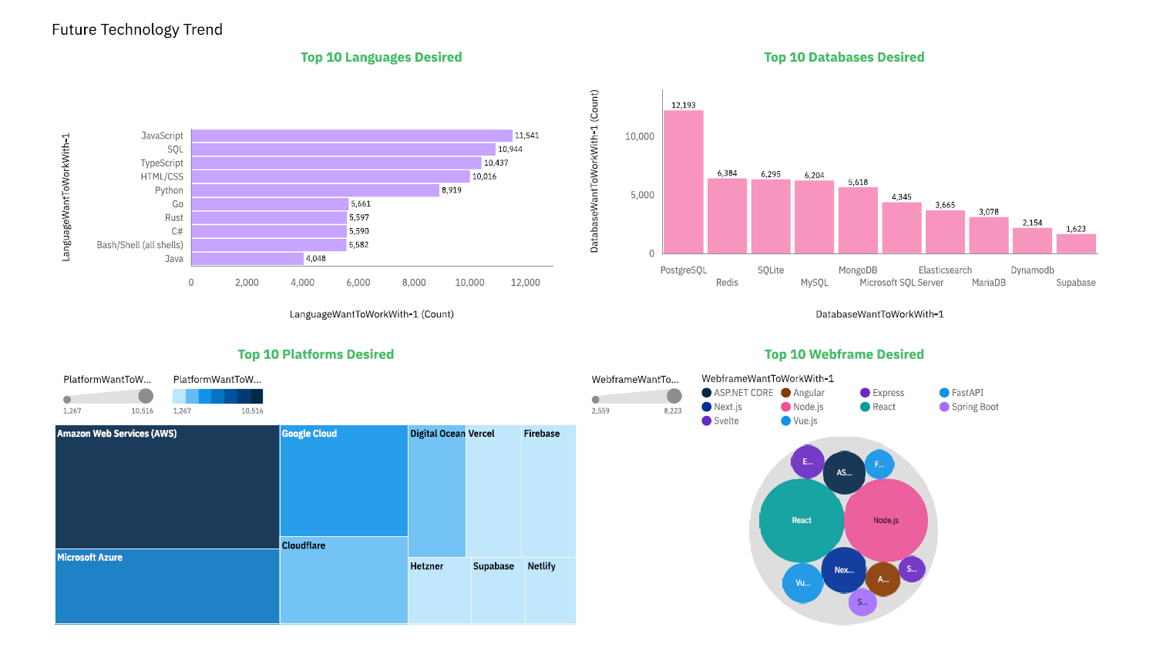
Future Technology Trends
Screenshot of dashboard tab 2 goes here

Slide 14
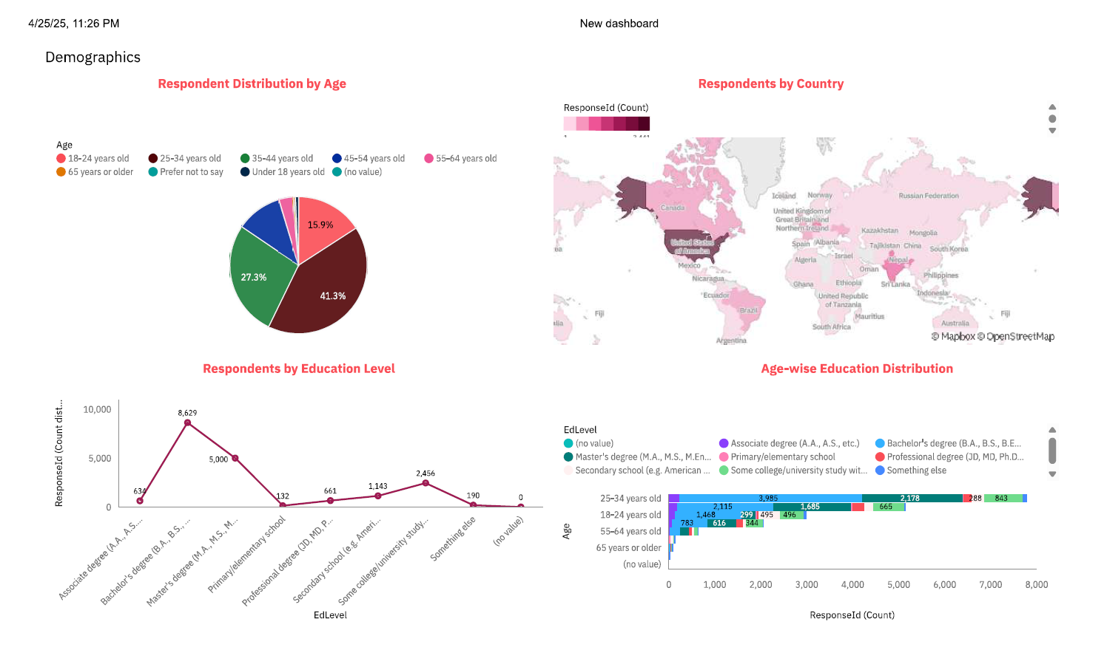
Demographics
Screenshot of dashboard tab 3 goes here

Slide 15

DISCUSSION
The dashboard reveals that Python, SQL, and MySQL are currently the most widely used technologies, highlighting their strong foothold in the industry.
Looking ahead, there is a noticeable shift toward cloud technologies like AWS and GCP, along with a growing preference for PostgreSQL, indicating that future demand will be cloud-driven and more open-source focused.
In terms of demographics, the majority of respondents fall in the 25–34 age group and typically hold a bachelor’s degree, suggesting that young professionals are leading technology adoption trends.
The data also shows a global spread, with high participation from countries like USA, India, and Germany, emphasizing the international nature of the technology workforce.
Finally, the analysis indicates that individuals with higher education levels tend to engage with a broader range of technologies, showing a positive correlation between education and technological adaptability.

Slide 16
OVERALL FINDINGS & IMPLICATIONS
Findings:
Python, SQL, and MySQL are the current top technologies in use.
Cloud platforms (AWS, GCP) and PostgreSQL are projected to dominate in the near future.
The age group 25–34 with a bachelor’s degree makes up the largest portion of the tech workforce.
Respondents are globally distributed, with strong presence in USA, India, and Germany.
Higher education is linked to broader and more diverse technology adoption.
Implications:
Continuous learning and cloud skills will be essential for staying relevant in the tech industry.
Organizations should invest in training employees in emerging cloud technologies.
Recruitment strategies may focus on young professionals with strong educational backgrounds.
Companies need to embrace globalization by considering diverse talent pools worldwide.

Slide 17

CONCLUSION
Python, SQL, and cloud technologies are key drivers in today’s tech landscape.
Future technology trends show a strong move toward cloud-native and flexible databases.
Young professionals with higher education dominate the tech workforce.
Global diversity is shaping the technology sector, with major hubs in the USA, India, and Germany.
Continuous upskilling is essential to stay competitive in the rapidly evolving tech industry.
Organizations must adapt to emerging technologies and diverse global talent for sustained growth.

Slide 18

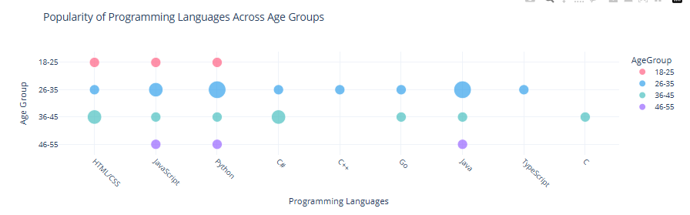
PROGRAMING LANGUAGE ACROSS AGE GROUP

Slide 19
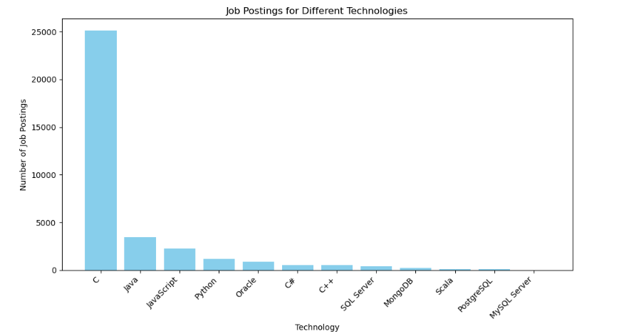
JOB POSTINGS

Slide 20
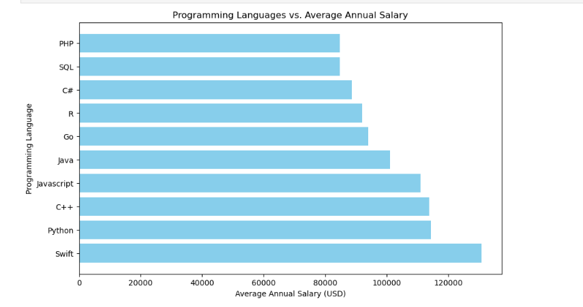
POPULAR LANGUAGES

